Slide 1
THE IMPACT OF AI ADVANCEMENTS ON U.S. STOCK MARKETS A CORRELATIVE STUDY OF AAPL, FB/META, GOOGL, & MSFT BY ALEXANDER, ANAND, CAMERON, JEAN, USHA OCTOBER 22, 2024

Slide 2
Objectives of the Study
Analyze the correlation between AI advancements and stock performance
Highlight key AI product releases: ChatGPT, Gemini/Bard, Microsoft Copilot
Provide insights on AI trends and forecasts

Slide 3
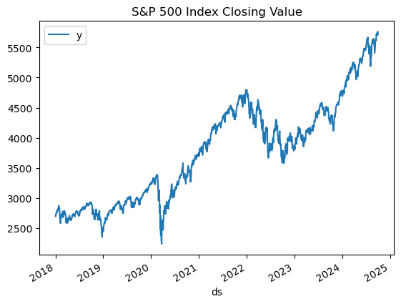
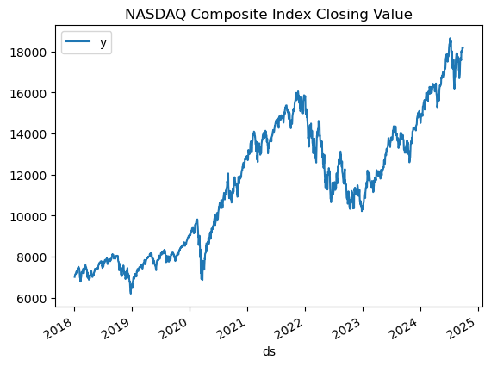
Stock Market Performance: S&P 500 and NASDAQ Composite Index Trends (2018–2025)

Slide 4
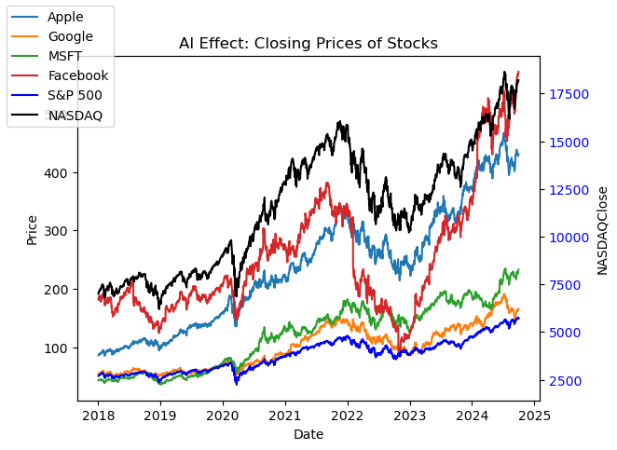
The Growing Role of AI in the Stock Market
Importance of AI in Shaping Financial Markets
Focus on key companies: Apple, Meta, Google, Microsoft

Slide 5
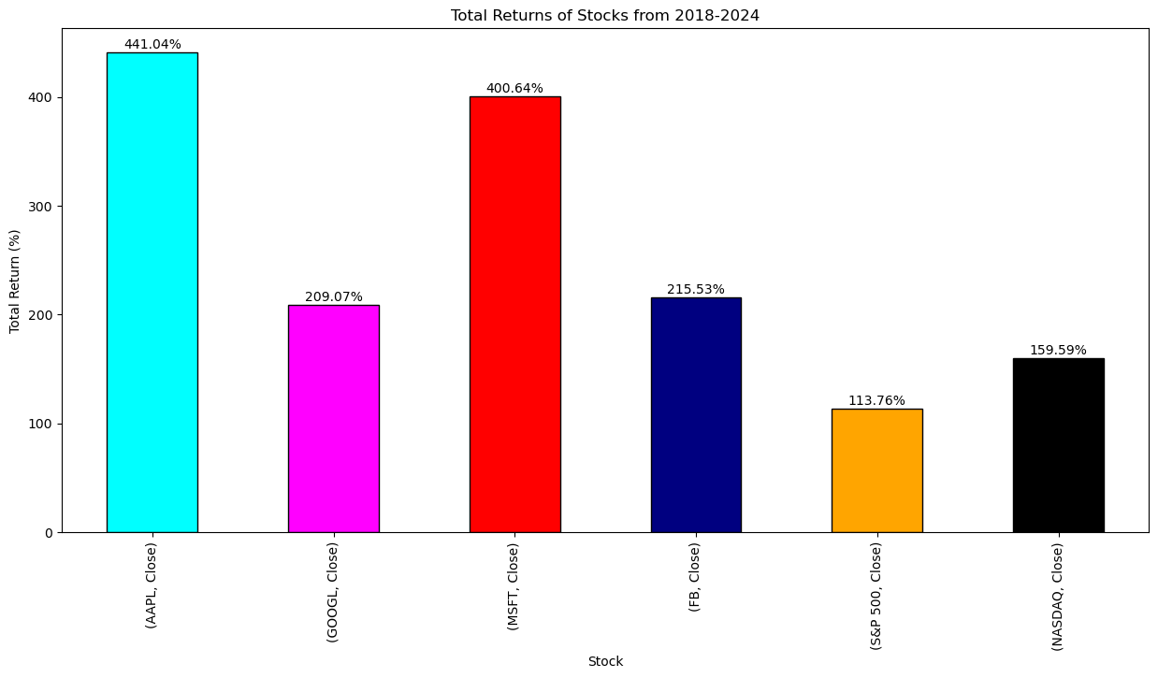
Why AAPL, FB/META, GOOGL, & MSFT?
Leaders in AI innovation and commercialization
Releases of key AI products (ChatGPT, Gemini/Bard, Microsoft Copilot+)
Significant influence on U.S. stock markets

Slide 6
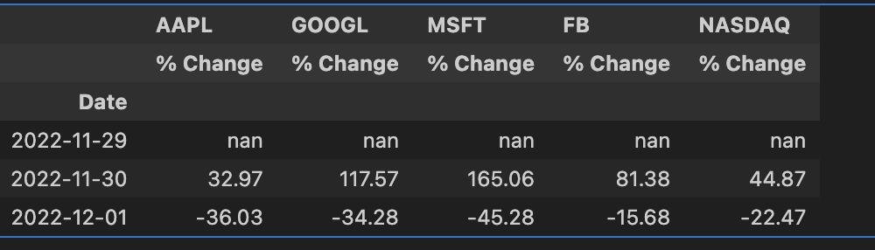
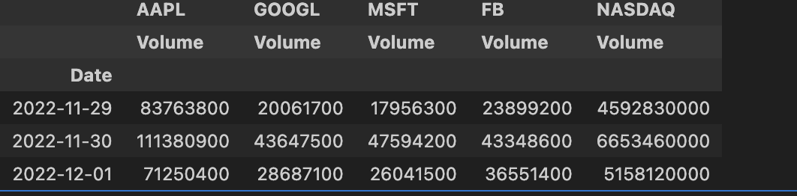
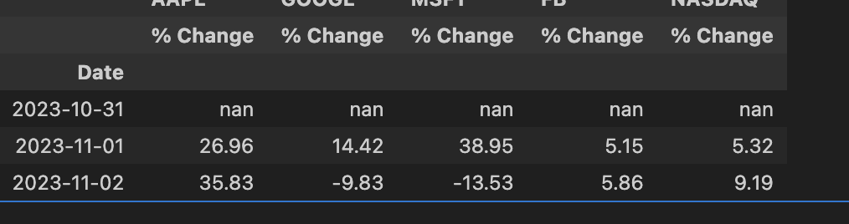
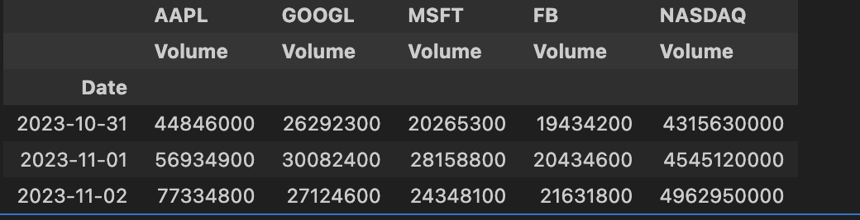
Major AI Product Releases
OpenAI’s ChatGPT
Google’s GEMINI/BARD
Microsoft’s CoPilot +
ChatGPT (late 2022) and integration with Microsoft Copilot+
Google’s Gemini/Bard and its Impact on search and advertising
Meta's AI algorithms driving platform engagement
Each release increased trading volume, rate, and stock value

Slide 7
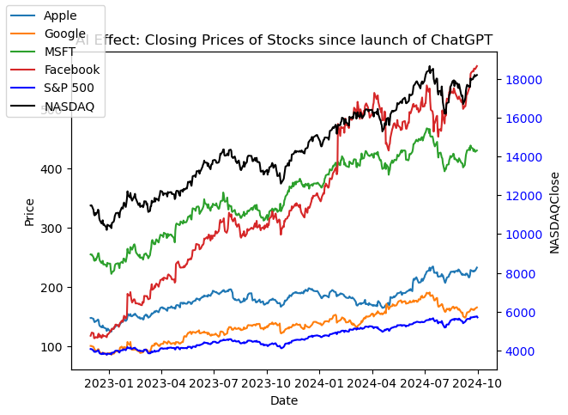
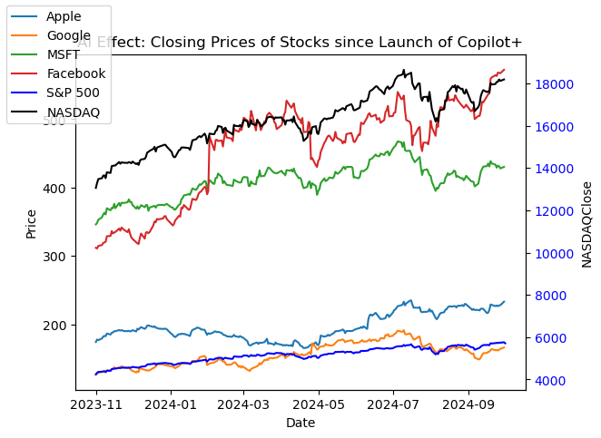
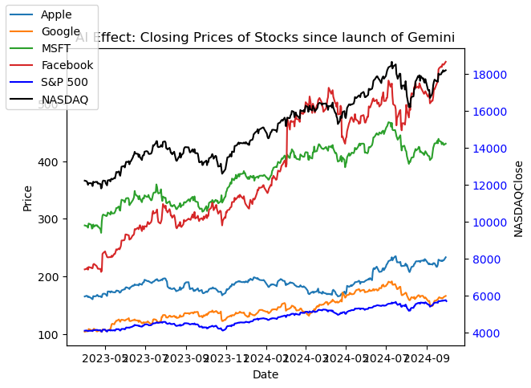
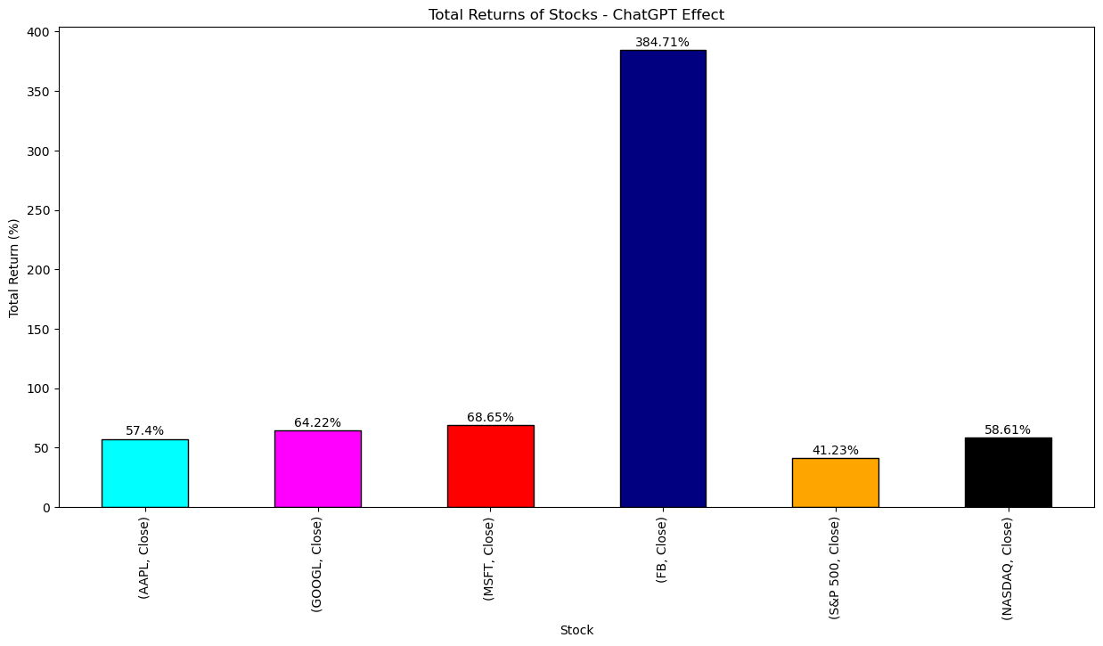
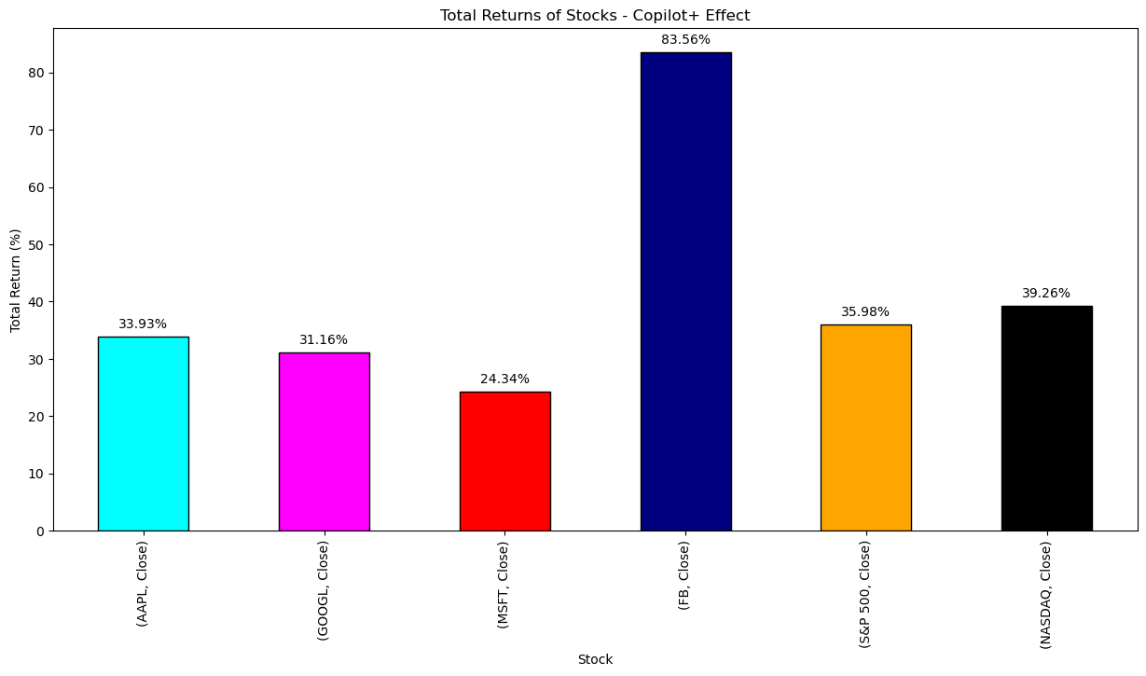
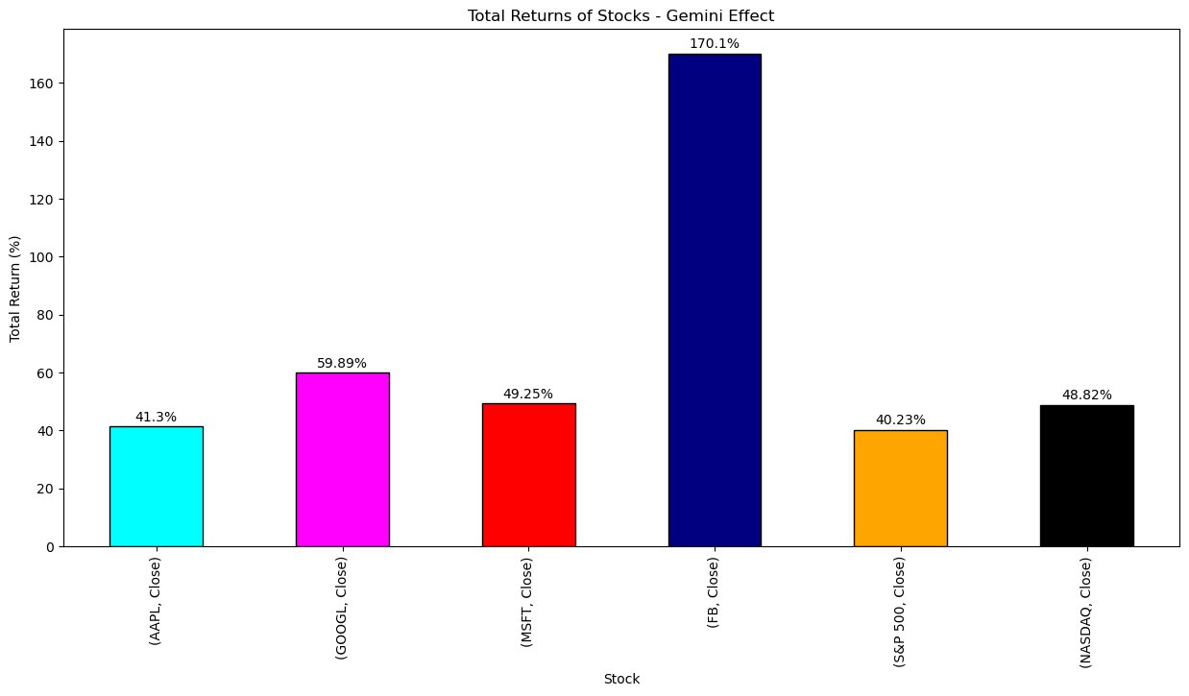
Correlation with Stock Performance
Stock price trends during major AI announcements
ChatGPT, Gemini/Bard Increased trading volumes and positive investor sentiment
Outperformance of AI-focused companies

Slide 8
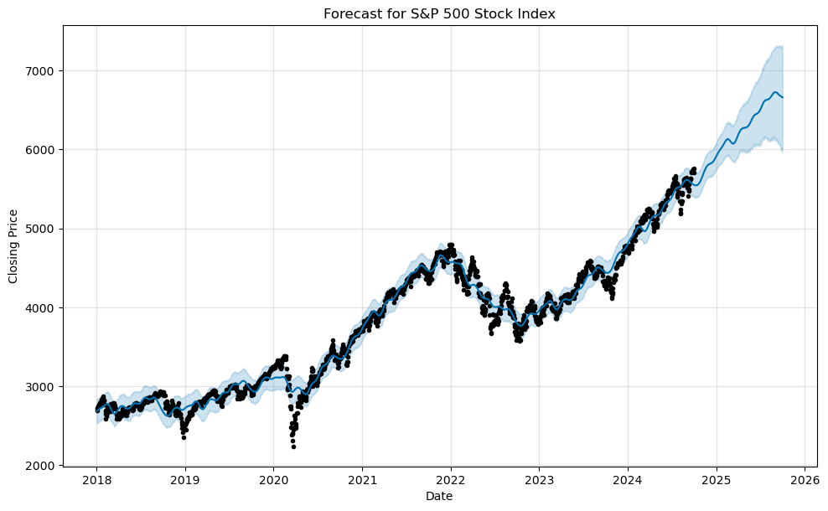
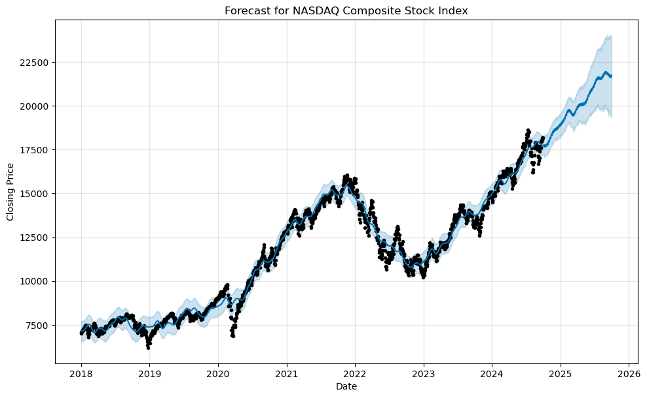
Investor Sentiment on AI Advancements
AI product releases driving market momentum
ChatGPT’ s integration boosting MSFT
Gemini/Bard impacting GOOGL
Correlation between AI news and trading volumes of S&P 500 and NASDAQ

Slide 9
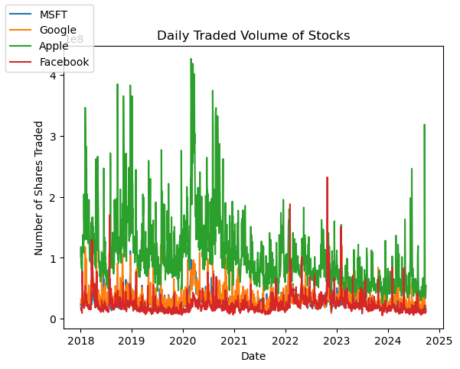
AI Advancements, Volatility, Risks
Ethical and regulatory concerns around AI
Market volatility following controversial AI developments
Stock declines during negative AI-related news

Slide 10
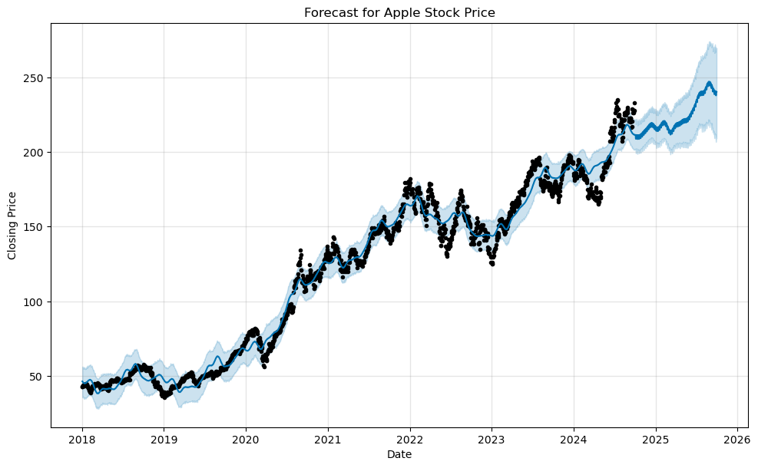
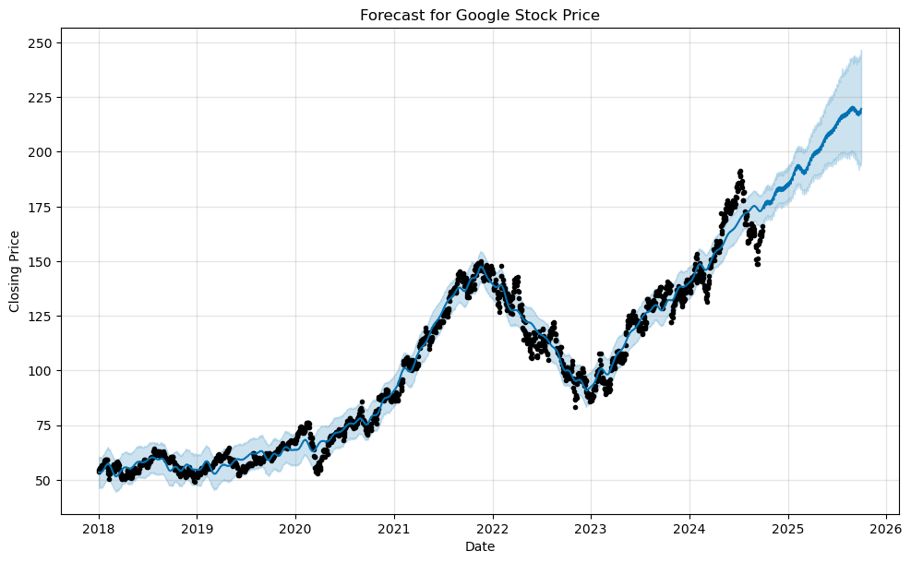
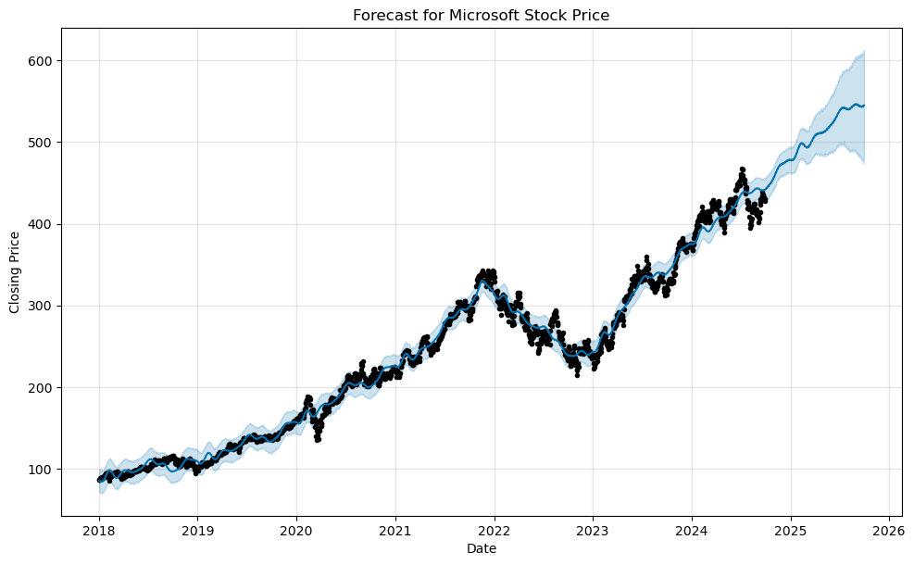
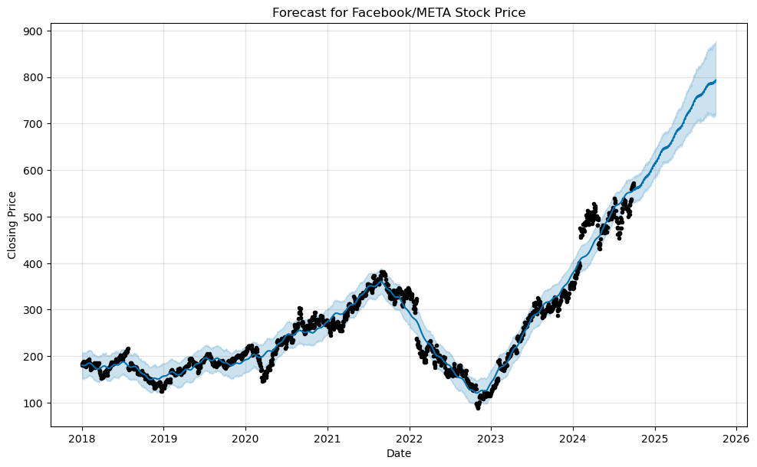
The Future of AI in Stock Markets
AI’s Growing Role in Stock Performance Through Innovation
Key factors for investors: monitoring AI products, regulations, market trend
Projected stock futures of AI leaders Microsoft, Google, Apple and Meta

Slide 11
Key Takeaways and Reflections
AI product releases (ChatGPT, Gemini/Bard, Copilot+) are major drivers of stock performance
Companies leading AI innovation show strong market results
Investors should closely monitor AI trends and regulations for future growth potential
Global markets, politics
Global AI trends
Global black swan events
Future focus
AI chips and hardware for quantum computing
AI-enhanced cloud solutions
Autonomous driving
Fintech AI
Personalized healthcare

Slide 12
REFERENCES
TBD

